Slide 1
COLOR DETECTION
INFORMATION TECHNOLOGY

Slide 2
ABSRACT:
Colour detection is the process of detecting the name of any color. Simple isn’t it? Well, for humans this is an extremely easy task but for computers, it is not straightforward. Human eyes and brains work together to translate light into color. Light receptors that are present in our eyes transmit the signal to the brain. Our brain then recognizes the color. Since childhood, we have mapped certain lights with their color names. We will be using the somewhat same strategy to detect color names.

Slide 3
In this color detection , we are going to build an application through which you can automatically get the name of the color by clicking on them. So for this, we will have a data file that contains the color name and its values.

Slide 4
Software & Hardware:
User Interface: Python 3
Packages: OpenCV package Pandas package Numpy package
Operating System: Any(Windows / Mac / Linux)

Slide 5
Backend : CSV file
Additional software: Microsoft Excel/ OpenOffice Calc/ Google Drive

Slide 6

1. Taking an image from the user

Slide 7
2. Read the CSV file with pandas
The pandas library is very useful when we need to perform various operations on data files like CSV. pd.read_csv() reads the CSV file and loads it into the pandas DataFrame. We have assigned each column with a name for easy accessing.

Slide 8
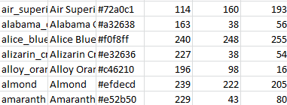
A sample list of colour's in data set

Slide 9
3. Mouse callback event
We set a callback function[draw_function()] which will be called when a mouse event happens.
It will calculate the rgb values of the pixel which we double click.

Slide 10
4. Calculate distance to get color name
We have the r , g and b values. Now, we need another function which will return us the color name from RGB values. To get the color name, we calculate a distance(d) which tells us how close we are to color and choose the one having minimum distance.
Our distance is calculated by this formula: d = abs(Red – ithRedColor) + (Green – ithGreenColor) + (Blue – ithBlueColor)

Slide 11
5.Final Colour Display:
Whenever a double click event occurs, it will update the color name and RGB values on the window.

Slide 12
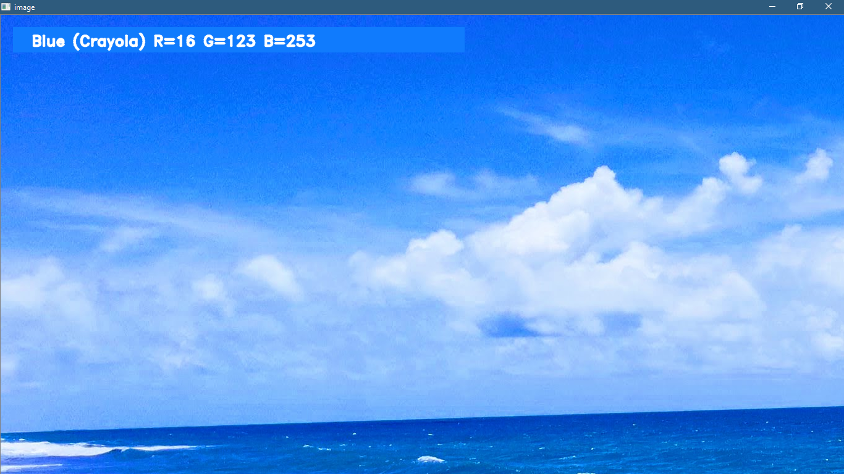

Slide 13


Image from User
Read CSV file with Pandas
Display the colour
Compare with dataset

Slide 14


Slide 15

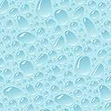
G Abhinaya Sri G phanindhar
M akila reddy

